Slide 1


a habit-tracker app for the wellbeing of the community
Created for BlueHacks 2019
By Joaquin, Kurt, and Kingsley

Slide 2

Identifying the problem
Self-doubt
Anxiety about the future
No avenue for self-actualization
Not having the chance to learn new things
Not having enough time for self-care
Lack of new friendships and relationships
Sedentary lifestyle
Unhealthy and imbalanced diet

Slide 3
Identifying the problem
Not enough healthy habits are being formed!
−








Slide 4
Solution
So we tried to make a habit-tracking app, Routaine.
Are the notifications easy to ignore?
What will motivate me to stick to my routines?

Slide 5
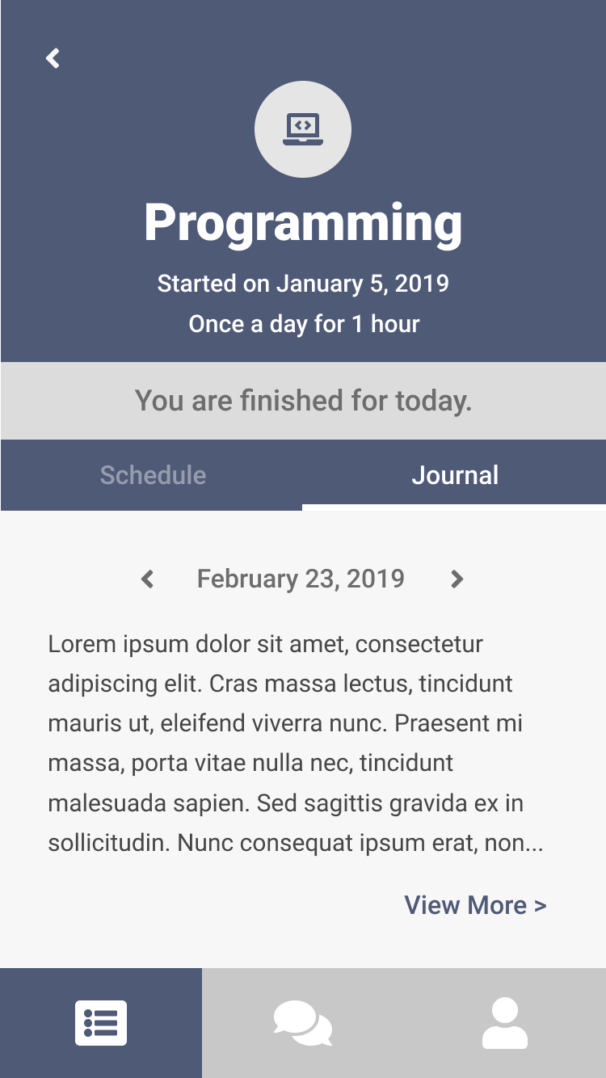
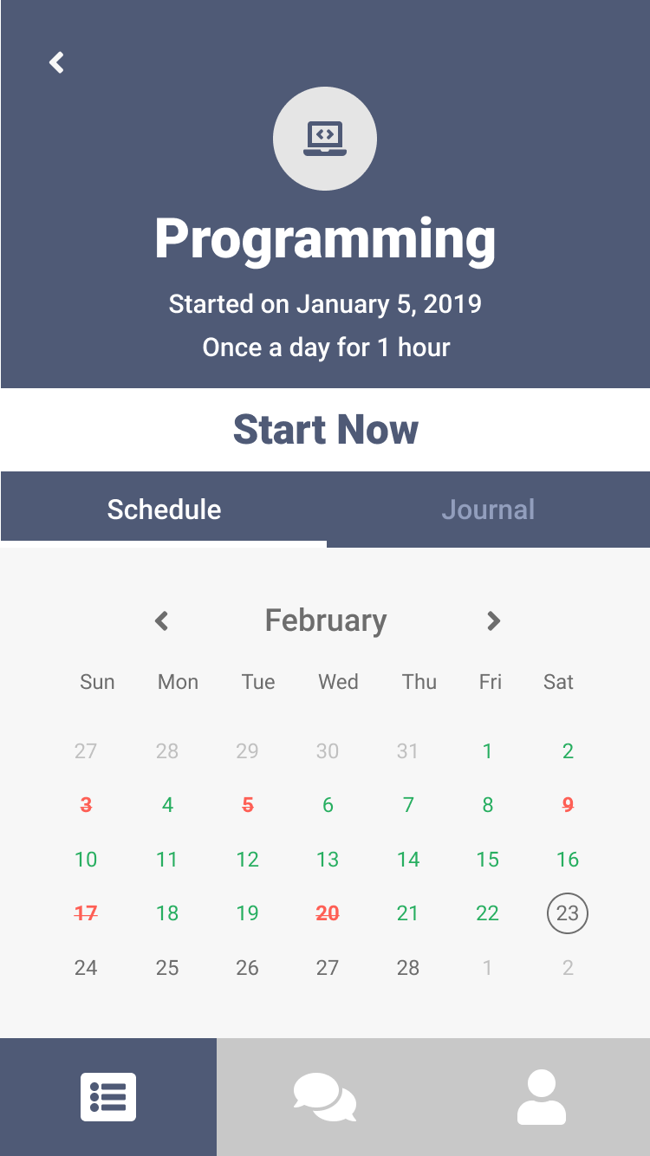
Features
Keeps track of
your progress and allows you to record journal entries as reminders.

Slide 6
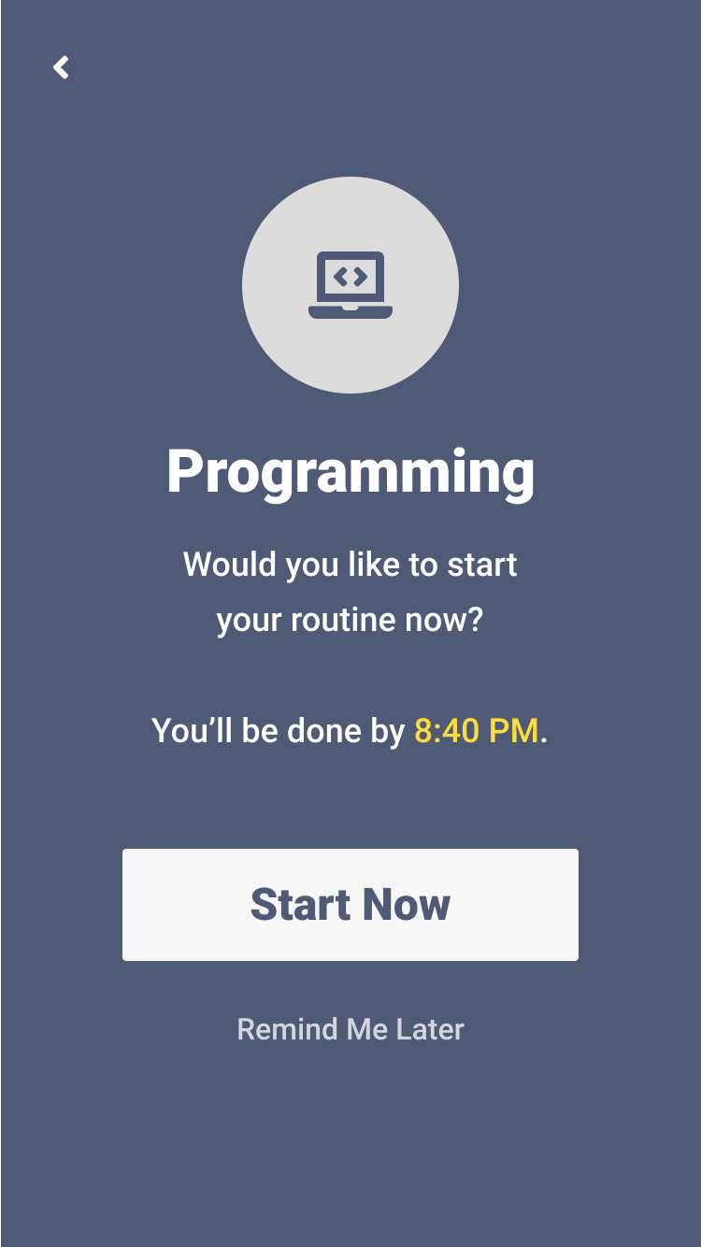
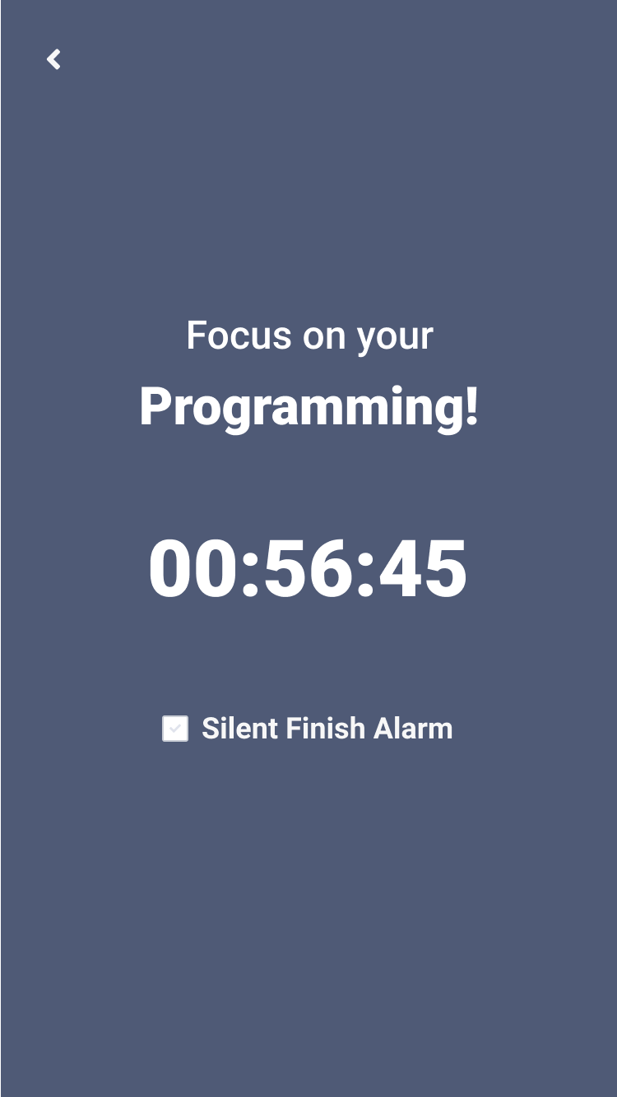
Features
Aggressively alerts to remind you of your routines.

Slide 7
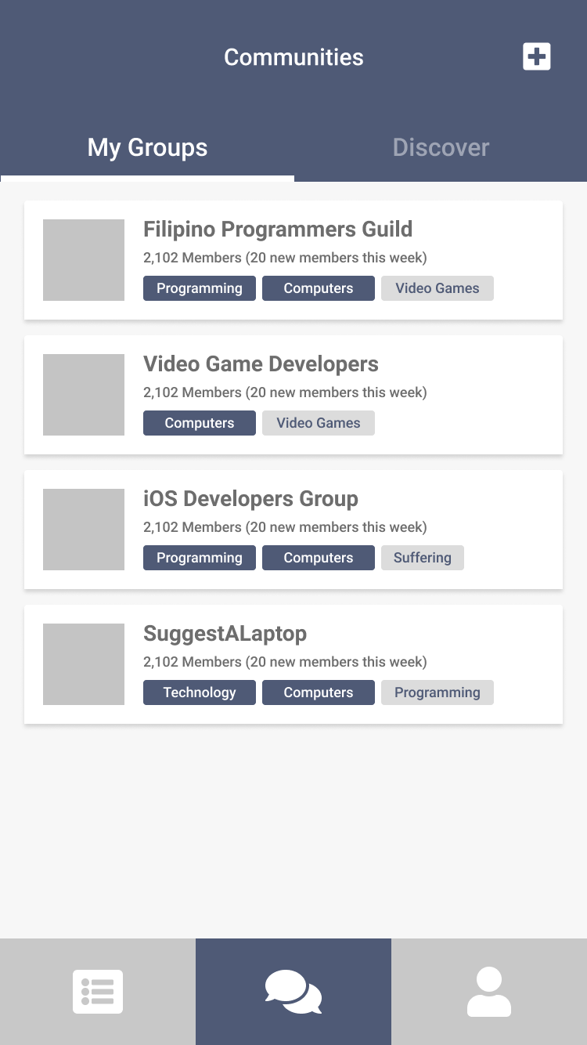
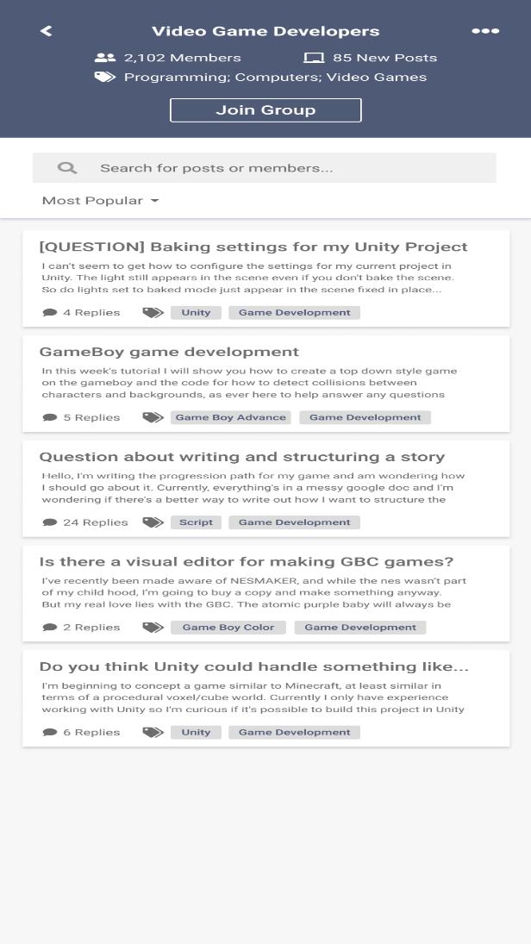
Features
Allows you to connect with users traveling the same journey as you are

Slide 8
Technologies used
Developed using Native iOS Development
Swift Programming Language
Realm Database

Slide 9
vision
We hope that Routaine becomes an avenue for people to learn and develop healthy habits that will lead to a positive growth in users’ everyday lives.

Slide 10
Plans for the future
Improve on the UI/UX implementation
Deeper native support for different routines
i.e. Step tracker for running routine
Ability to view other users’ routines and journals

Slide 11
Thanks for listening!

